Slide 1
AMDIE - Infomineo Data Analytics Services

Slide 2

Agenda
1. Data Analytics Services
2. Contexte & Proposition de solution
3. Budget & Next Steps

Slide 3
Data Analytics Services

Slide 4







Infomineo services – Transforming data into impact
Analysis
Communication
Data
Business Research
Finding and analysing external data
Insights
Graphic Design
Converting insights into visual communication
Impact
Data Analytics
Cleaning and analysing large data sets
Content services
Converting insights into written communication

Slide 5




Infomineo offers a full suite of Data Analytics Services
Analytics
Three Levels of Analytics
Business Oriented Approach
Three Types of Data Services
Brainshoring: business sense and critical thinking applied to our clients’ problems
Acquire and Prepare
Unleash the power of Information
Discover, assess, clean, and transform Data from multiple sources with ease
Data Exploration
Statistical Analysis
Data Visualization
We work in an iterative approach to be always align to our clients’ needs and expectations
Data
Analysis
Business and Data Understanding
Agile Methodology
Analyze
Empower your business with dynamic insights with unified Self-Service Analytics;
Tackle critical business challenges using cutting-edge models
Data
Science
Model building and tuning
Model evaluation and retraining
Delivery Management
Data Sourcing and Integration
Data Cleaning and
Feature Engineering and Data transformation
Model Deployment and scalability
Data Engineering
We take care of release and change management, including versioning, unit tests, model validation, documentation, etc.
Deploy
Bringing Models to Life
Seamless deployment, monitoring, and integration into client's infrastructure for maximum impact

Slide 6
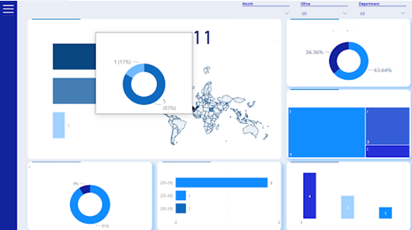
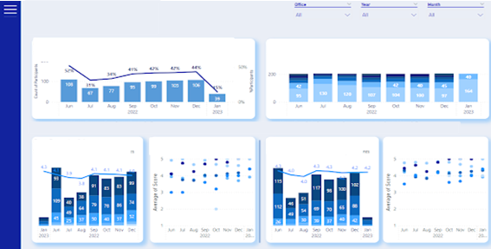
Use Case Example : A Comprehensive Dashboard of Key Metrics and Performance Indicators
Achievements
A data model has been elaborated considering that 5 tools were identified to contain the Data source needed
14 source reports have been created and their extractions’ have been automatized using APIs
Data Quality Checks have been automatized given business rules
The Report created contained 3 main sections : Administrative, Professional Development, Recruitment
A full-fledged report with 30 Dashboards, 150+ graphs and 50+ KPIs

Slide 7
Contexte & Proposition de solution

Slide 8
Contexte & Proposition de solution : Baromètre des salaires
Exemple d’interpolation des salaires via l’écart à la moyenne nationale sur la région
L’équipe Business Research a recueillie auprès de diverses sources de nombreuses données sur les salaires des ingénieurs et techniciens au Maroc.
L’AMDIE souhaiterait avoir un baromètre salarial multi- critères :
Example par Brahim
carte
Profil d’employé
Séniorité
Salaire net vs Brut
Répartition par région

Slide 9


Contexte & Proposition de solution : Dashboards des clusters
L’équipe Business Research a collecté des données pour créer un ensemble de reports et KPIs autour de 4 thématiques sur Excel :
Capital Humain
Logistique
Energie
Foncier (en cours de construction)
Grande volumétrie des datasets
Expérience utilisateur non optimale
Définition d’un ensemble de KPIs multi-critères
Création de Dashboard interactifs
Proposition de Solution
Example par Brahim

Slide 10
Budget & Nest Steps

Slide 11
Nacer

